Slide 1
International Amateur Radio Union

Slide 2
My agenda today
The radio spectrum today
Overview of IARU – its history
IARU today and its work

Slide 3
The radio spectrum
In ever-increasing demand
Traded at very high prices
Pressure on users to release spectrum (esp. government & military)
Amateur Radio cannot “buy” spectrum
Amateur spectrum is only acquired and retained through professional level advocacy and well-researched argument

Slide 4
The ITU and global spectrum allocation
ITU is the United Nations specialized agency for information and communication technologies – ICTs.
It allocates global radio spectrum and satellite orbits, develops the technical standards that ensure networks and technologies seamlessly interconnect, and strives to improve access to ICTs to underserved communities worldwide.

Slide 5
Spectrum allocation in the past
Principally concerned ITU and the national regulators
ITU reached decisions at WRCs through voting
To “win” spectrum, a majority of member states needed to be in favour of the change
Amateur radio service made significant gains
Now, much has changed with new spectrum stakeholders

Slide 6
Spectrum Allocation today
Emerging role of the RTOs – Regional Telecommunications Organisations
Each RTO tries to develop a common position representing the views of its members
ITU now works by consensus – one country can block a proposal
A much harder environment in which to make progress

Slide 7
Spectrum “Regulators”
ITU and six Regional Telecommunications Organisations:
  APT – Asia Pacific
  ASMG – Arab states
  ATU – Africa
  CEPT – Europe
  CITEL – Americas
  RCC – Commonwealth of Independent States (of the former Soviet Union)

Slide 8
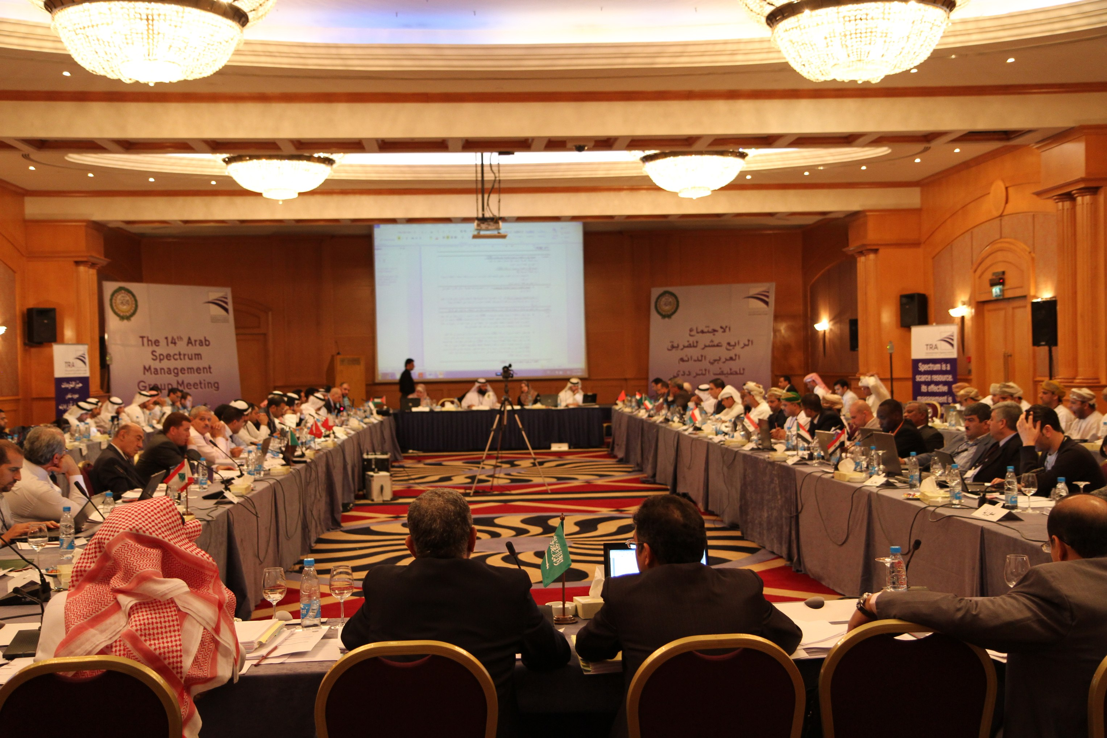
ASMG meeting - Lebanon

Slide 9
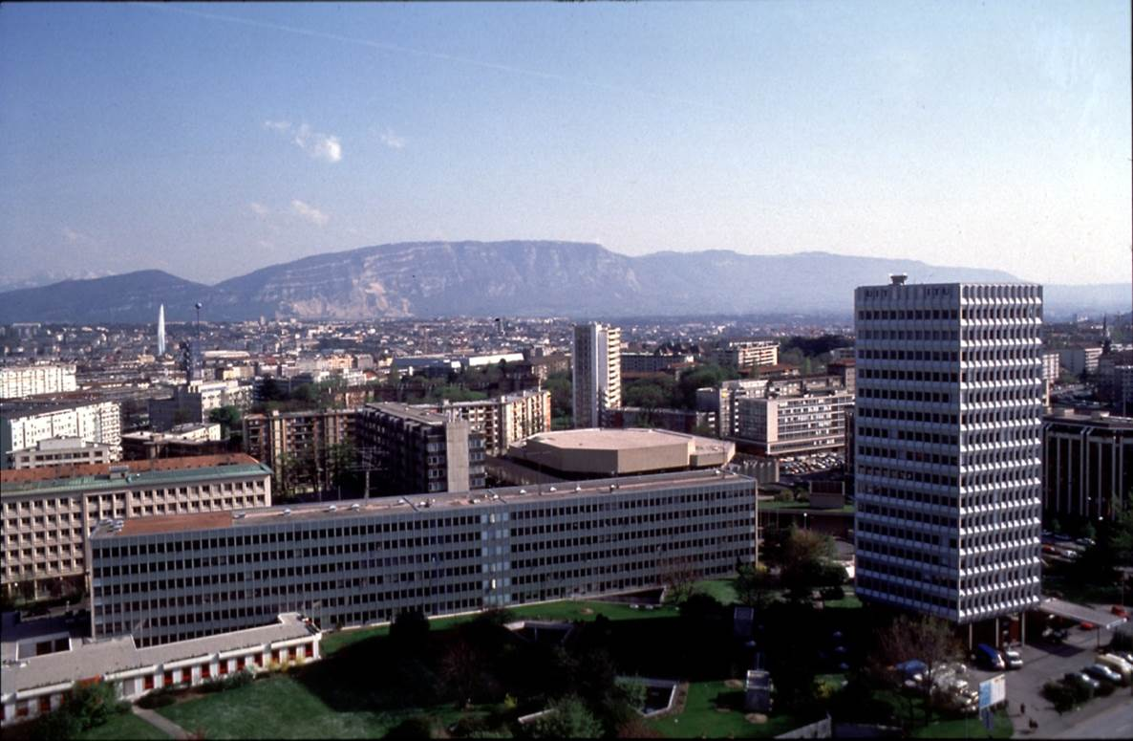
Achieving agreement - ITU
ITU working parties
and WRC
RTOs - study groups
and plenary
National administrations

Slide 10
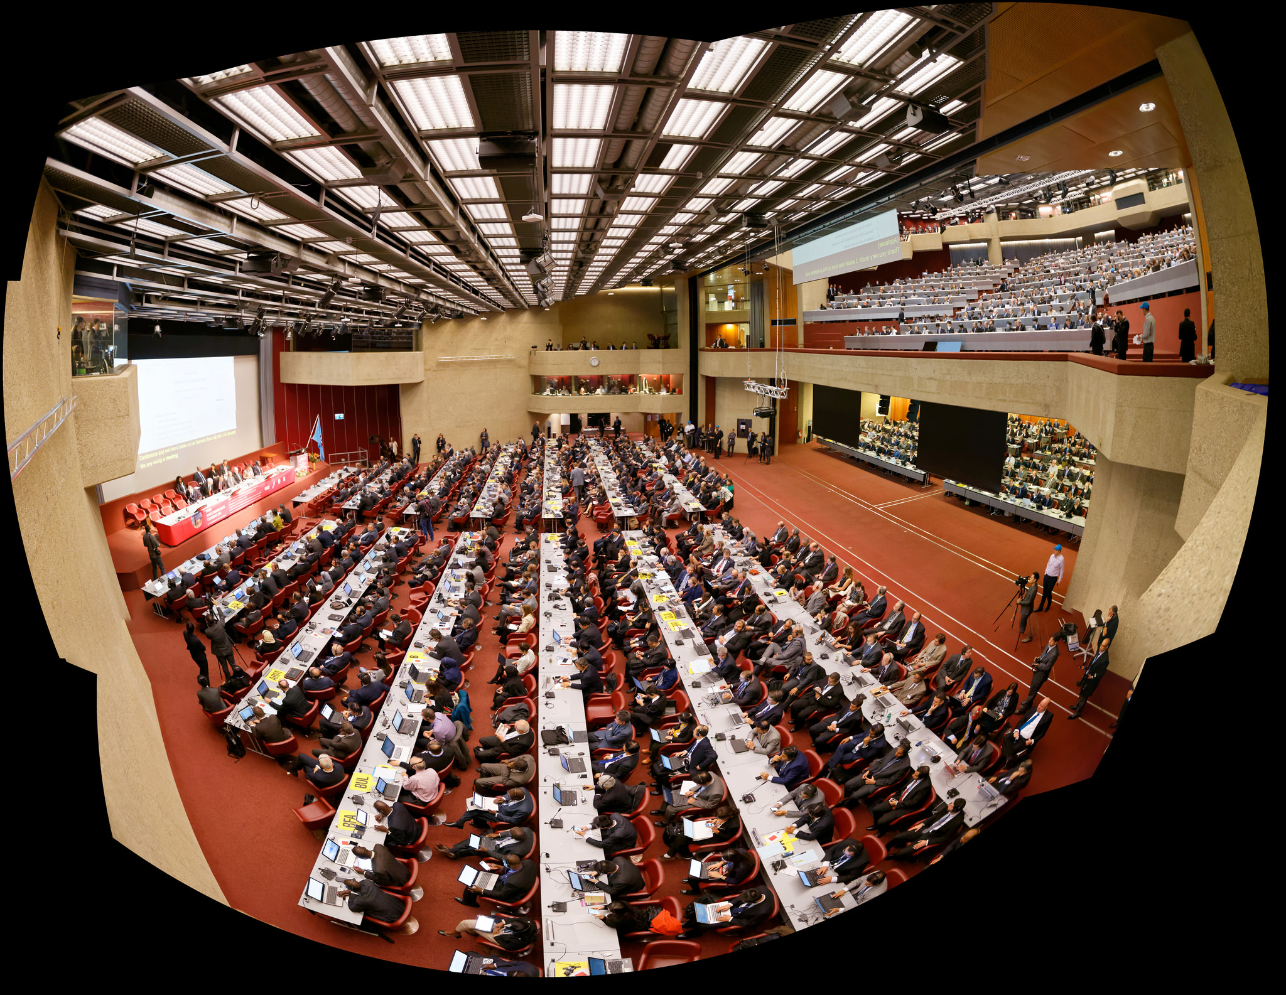
A WRC
WRC 2015

Slide 11
Other “Regulators”
Standards Organisations:
ETSI – European Telecommunications Standards Institute (for Europe)
CENELEC – European Committee for Electrotechnical Standardization (for Europe)
CISPR - International Special Committee on Radio Interference (global)
All aimed at influencing EMC standards to ensure appropriate protection for radio services
Representation of “interested” equipment manufacturers, as well as national standards organisations

Slide 12
Influencing spectrum decisions
Multiple points of involvement
A complex process – both spectrum allocation and EMC
Resource-hungry
Time-consuming
Amateur Radio needs a single voice with a clear message

Slide 13
The Role of IARU in spectrum issues

Slide 14
What is IARU?
The “umbrella” organisation of national amateur radio societies
167 national amateur radio societies as members
Comprising three Regions and the International Secretariat
Its team is made up entirely of volunteers
Its core remit is
  Development of amateur radio spectrum access through discussion and negotiation with ITU and Regional Telecommunications Organisations
  Advocacy for standards to keep the spectrum as far as possible available for use
IARU works closely with its Member Societies in its work

Slide 15
IARU from the beginnings
1925 IARU founded in Paris
1927 Washington Radiotelegraph Conference sets out frequency bands for amateur radio
1932 ITU admits IARU to participation in CCIR (later the Radiocommunication Sector)
1938 ITU creates the three Region structure for frequency allocations
1950 IARU Region 1 formed
1962 4U1ITU station created as “showcase” for amateur radio in ITU
1964 IARU Region 2 formed
1968 IARU Region 3 formed
1980 IARU Administrative Council formed with new Constitution (1984)

Slide 16
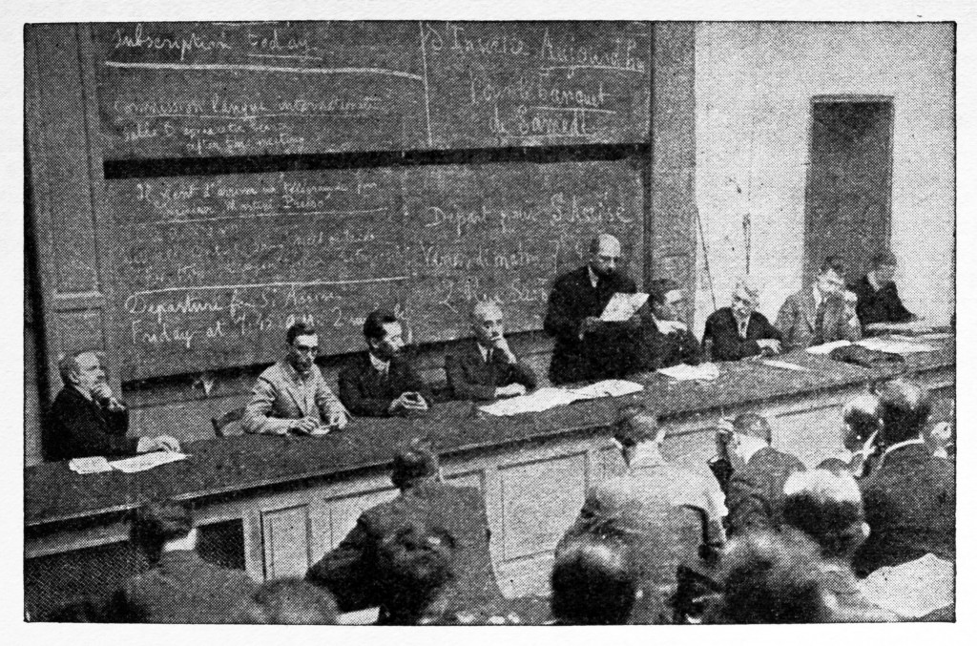
The first IARU Congress – Paris, 1925
Those present included:
Hiram Percy Maxim, W1AW (ARRL)
Kenneth B Warner, W1EH (ARRL)
Leon Deloy, F8AB
Gerald Marcuse, G2NM (RSGB)
William Borrett, C1DD (Canada)
Loyal S Reid, C8AR (Newfoundland)
and representatives of 23 other
countries.

Slide 17
IARU today
International Secretariat
Region 1 – Europe,
Africa, Middle East,
N Asia
Region 2 - Americas
Region 3 – Asia-Pacific
167 Member Societies

Slide 18
Some IARU Achievements
21 MHz band globally (WARC 1947)
Amateur Satellite Service created (WRC-Space 1971)
10, 18, 24 MHz bands globally (WARC 1979)
More amateur-satellite bands (WARC 1979)
Improved 1.8 MHz band (WARC 1979)
7 MHz extension (WRC 2003)
136 kHz band globally (WRC 2007)
472 kHz band globally (WRC 2012)
Small global 5MHz band (WRC 2015)
Improvements in international roaming for radio amateurs (CEPT & CITEL)
Global 50 MHz band sought at WRC 2019 – mainly affects Region 1

Slide 19
Other IARU work with ITU
A sector member in ITU-D (focus on emergency communications)
  Development of the Emergency Communication Handbooks and Manuals
Participation in other ITU initiatives:
  Smart Sustainable Development Model
  Spectrum Management Training Program
  Amateur Radio Administration Courses
All to support spectrum advocacy mission

Slide 20
IARU influence - EMC
Inclusion of EMC requirements for ELV LED lights
New Requirements for photovoltaic inverters set
PLT standard EN 50561-1 which protects amateur spectrum
Limits for Plasma-TVs below 30 MHz
Milestones in preventing spurs from WPT systems
Include requirements for amateur radio into the EMC database of CISPR
Starting a debate about multiple sources disturbances

Slide 21
IARU people today
President, Tim Ellam, VE6SH
Vice President Ole Garpestad, LA2RR
Secretary Dave Sumner, K1ZZ

Slide 22
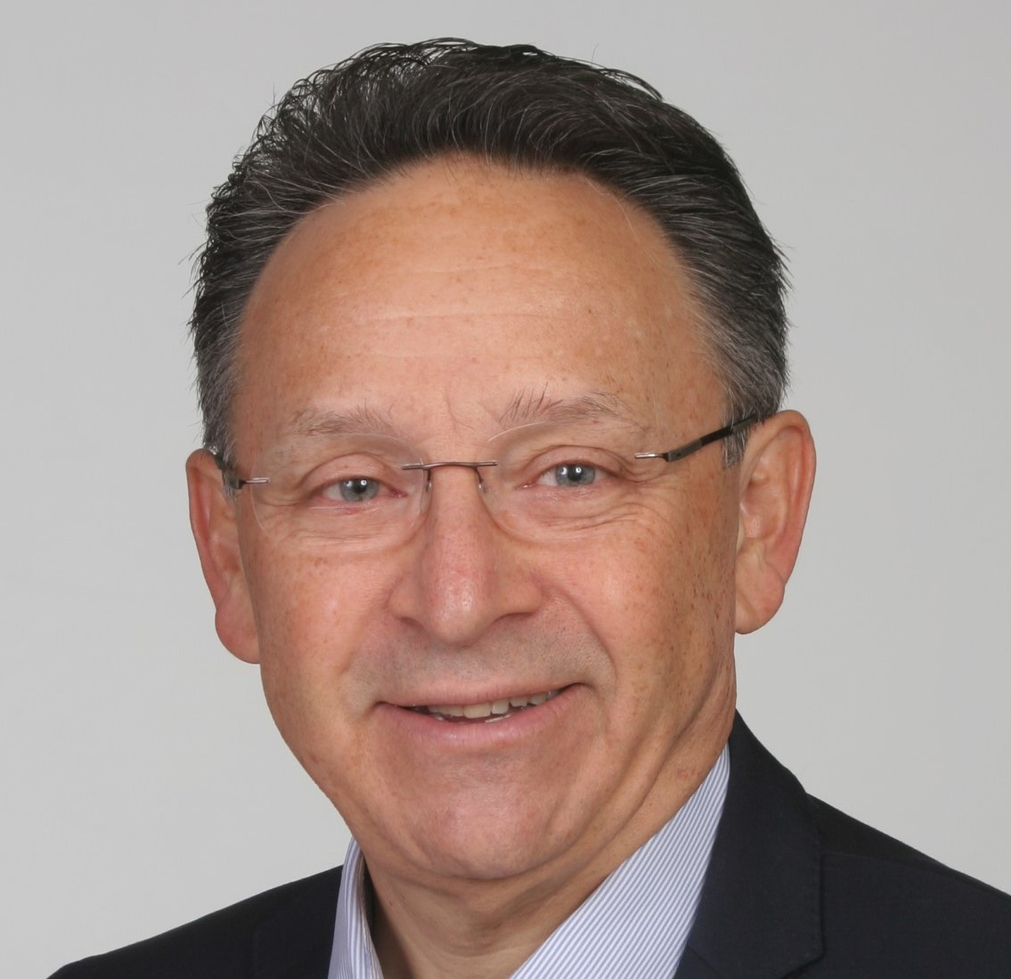
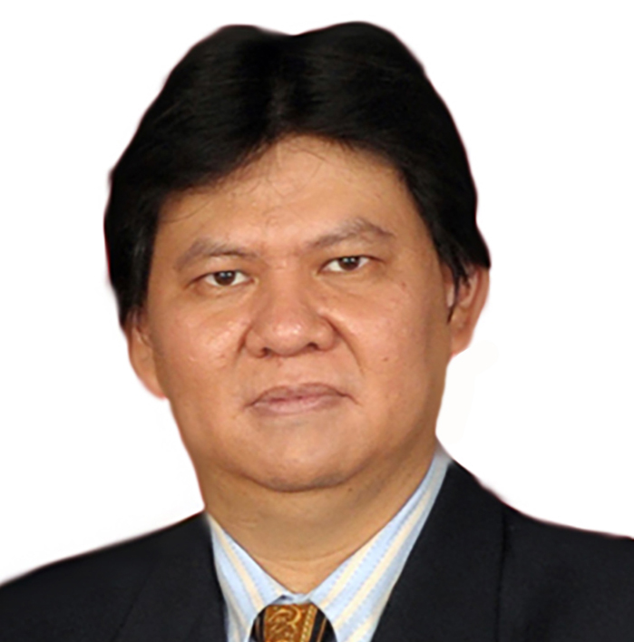
IARU people today
President, Region 1, Don Beattie, G3BJ
President, Region 2, Ramón Santoyo, XE1KK
Chairman, Region 3, Wisnu Widjaja, YB0AZ

Slide 23
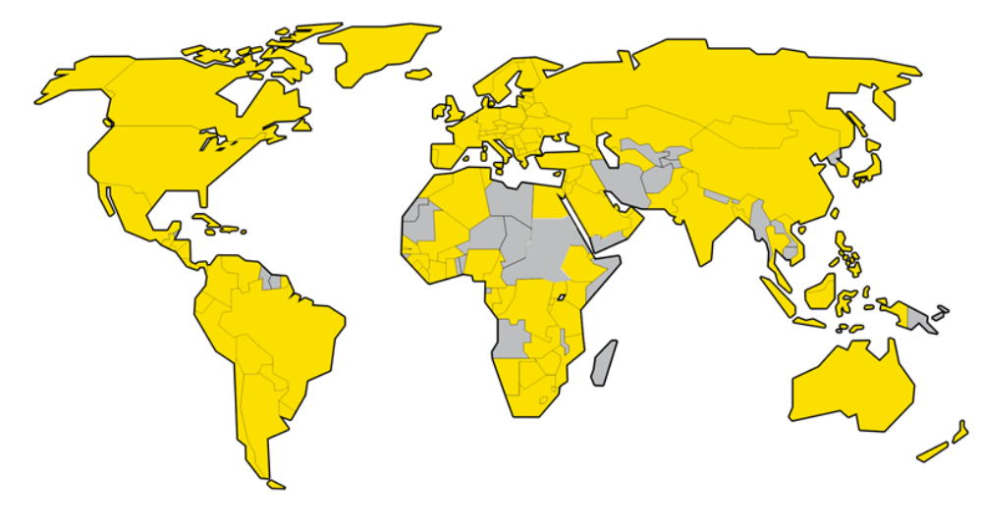
IARU covers the globe
IARU member society

Slide 24
IARU Funding
Fees paid to Regional organisation based on number of amateur licences. eg Region 1: 1.8 CHF (£ 1.30) per society member
10% of that income goes from Regions to fund the IS
ARRL provides significant additional funding to the IS
Funding is under stress with reduced income and increased demands on IARU
12 societies provide 82% of the funding in Region 1

Slide 25
IARU Region 1 Societies
Europe: 54
Africa: 35*
Middle East and N Asia: 12*
* A small number temporarily suspended due to lack of activity

Slide 26
The Amateur Radio spectrum today
How we work for your interests

Slide 27
IARU relationships
International Secretariat
ITU and CISPR
ITU
CEPT
ATU
ASMG
RCC
CENELEC
ETSI
Region 1 – Europe,
Africa, Middle East,
N Asia
Region 2 – Americas
ITU
CITEL
ITU
APT
Region 3 – Asia-Pacific
Member Societies RTO, National Regulators & National Standards Organisations (with IARU support)

Slide 28
Spectrum is in demand
Three ways IARU might make progress:
New spectrum acquisition
Spectrum consolidation – rationalising the amateur allocations across the world ( 1.8 MHz, 7 MHz, 50 MHz)
Spectrum retention – keeping what we have today

Slide 29
How does IARU work?
A small group of “expert consultants” – all volunteers – work together in a globally coordinated way to:
  Develop the IARU strategy for each WRC
  Seek support from national regulators (through national member societies)
  Coordinate the IARU strategies towards each RTO
  Respond to inputs from national administrations in RTOs and ITU
….with the objective of securing agreement in each RTO before the WRC is held. “Think global – act local”
WRCs work by consensus, not voting – one administration can block anything

Slide 30
How coordination works
Administrative Council develops strategy with expert consultants and agrees with Regions
Work plan developed for each RTO and papers prepared for submission
Member Societies seek support from their administrations to the IARU proposals
Series of studies and counter-proposals from administrations
Hopefully eventual support for IARU position
Discussions in ITU continue in parallel – various working parties
Final resolution at a WRC

Slide 31
Achieving agreement
ITU working parties
and WRC
IARU proposals to ITU via national administrations
RTOs - study groups
and plenary
IARU Regional expert consultants present IARU proposals
National administrations
Member Societies discuss proposals with administrations

Slide 32
A long process
ITU WRC 4 weeks each WRC
ITU WP5A 4 weeks each year
ITU CPM 2 weeks each WRC cycle
CEPT ECC
CEPT WGFM
CEPT CPG
CEPT PTA
CEPT PTD
Other sub-groups As required
12+ weeks each year

Slide 33
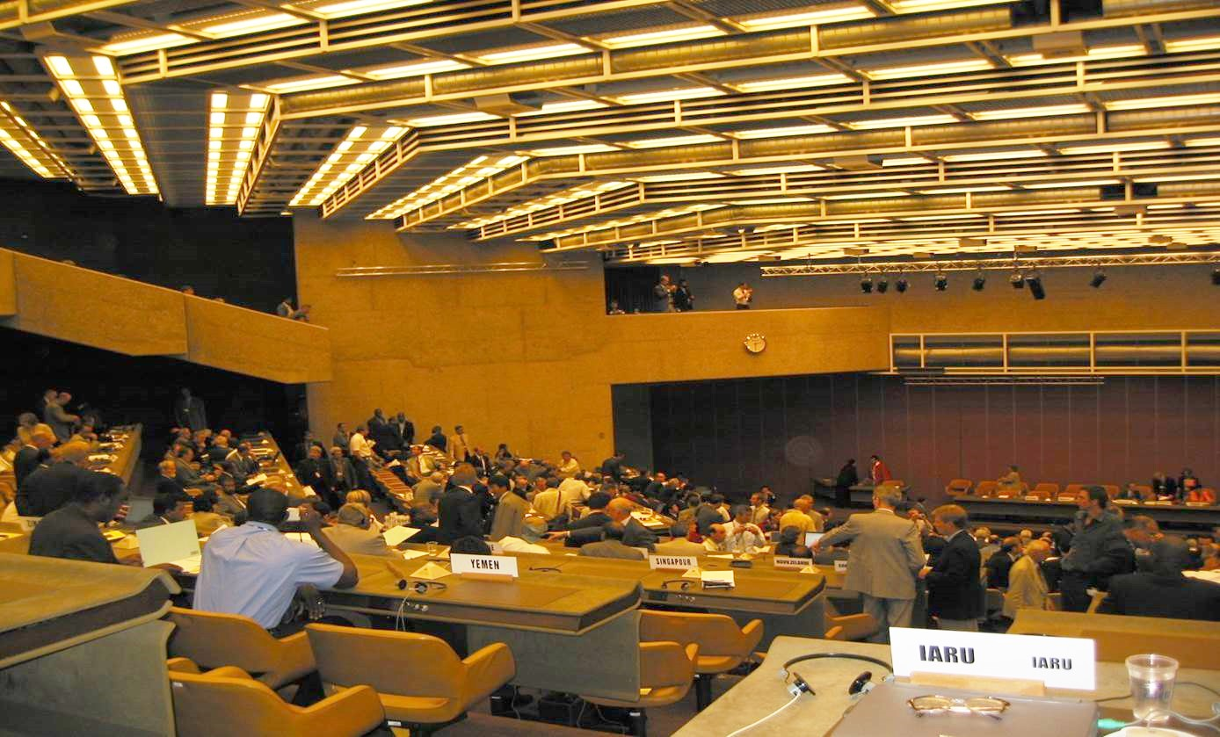
Another view
of WRC 2015

Slide 34
WRC-15 – some statistics
3079 – total delegates
162 – number of countries represented
170 – largest delegation
6am – latest finish to Plenary meeting
9am – start time later the same morning

Slide 35



Achieving agreement - EMC
CISPR
National standardisation
bodies
IARU
IARU Member Societies

Slide 36
The simple view of CEPT
Electronic Communications
Committee - ECC
WG FM
Frequency Management
WG SE
Spectrum Engineering
Conference preparatory
Group - CPG
Project Team 1
Mobile (IMT)
IARU normally represented
IARU represented on some /
as needed
Sub-groups
Sub-groups
Four Project Teams

Slide 37
A long process
Electronic Communications
Committee - ECC
12
15
WG FM
Frequency Management
WG SE
Spectrum Engineering
Conference preparatory
Group - CPG
Project Team 1
Mobile (IMT)
10
10
10
12+
Time commitment
days per year (+ preparation
time)
Sub-groups
Sub-groups
Four Project Teams

Slide 38
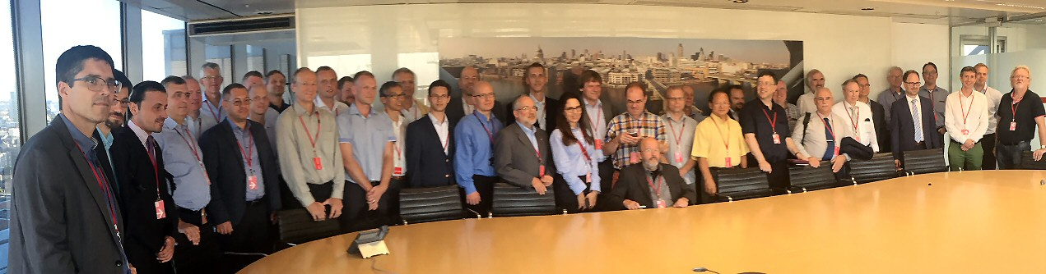
One of the smaller CEPT meetings (SE24)

Slide 39
Key agenda items at WRC 19
1.1 Amateur allocation in Region 1 in the 50-54 MHz region
1.7 Non-GSO satellites
1.11 Trackside communications
1.13 Spectrum for international mobile telecommunications 24-86 GHz
1.15 275-450 GHz mobile and fixed services
1.16 RLAN at 5 GHz
9.1.6 Wireless power transfer spectrum

Slide 40
Example: Agenda item 1.1 - 50MHz
In CEPT:
A case for the requirement generated by IARU – challenged by some country administrations
Some support and a conditional draft ECP
Concerns from some countries about sharing with residual band 1 television, mobile services and wind profiler radars.
Sharing studies conducted – disagreements about the methodology
Protection criteria to be developed
No guarantee of successful outcome at WRC

Slide 41
Example: Wireless Power Transmission
Initiated at WRC15 – to determine spectrum for WPT(EV)
Work continued in ITU (SG1), CEPT (SE24), CISPR and ETSI
ITU trying to bring all discussions to a common position
Commercial pressures are enormous
Regulators are less than supportive
Military are silent (despite a briefing of NATO)
Only voices are EBU, BBC and IARU
WPT the biggest threat to amateur radio for years

Slide 42
Resourcing ITU/RTO work
A small number of experts carry the workload
We are all getting older!
Time demands are increasing
IARU needs more people with the skills to join this work
We need to find more funding
Join your IARU national society – help fund the work
Talk to us if you think you can help in a consultant capacity - please

Slide 43
Resourcing
If you have spectrum management or international standards experience
or
If you have experience of working with your national regulator
or
If you feel you can learn the skills quickly
and
If you have the commitment to help take Amateur Radio forward
- please speak to us!

Slide 44
The future of Amateur Radio
EMC issues in the suburban environment – especially WPT
Declining number of licences in some countries
Increasing commercial pressure on spectrum
A more complex process to allocate spectrum – RTOs + ITU
Insufficient effort to attract new entrants into Amateur Radio
- all mean that the Amateur Radio voice could be less prominent in important forums in the future.
We need to ensure we have the financial resources and skills to properly represent Amateur Radio and ensure its future health

Slide 45
The imperatives
Programmes to attract new people into Amateur Radio
Strong Member Societies, not fragmentation
A strong and unified global voice for Amateur Radio - IARU
Professional skills representing our case – need for more volunteers
This is the time for single-minded commitment to take Amateur Radio forward

